Slide 1
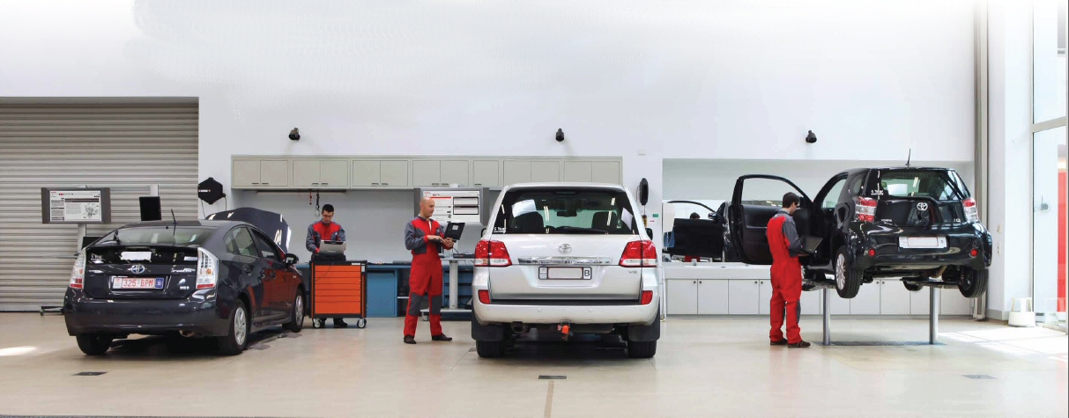
TechDoc 3
User Guide
NMSC Bulletin Upload

Slide 2
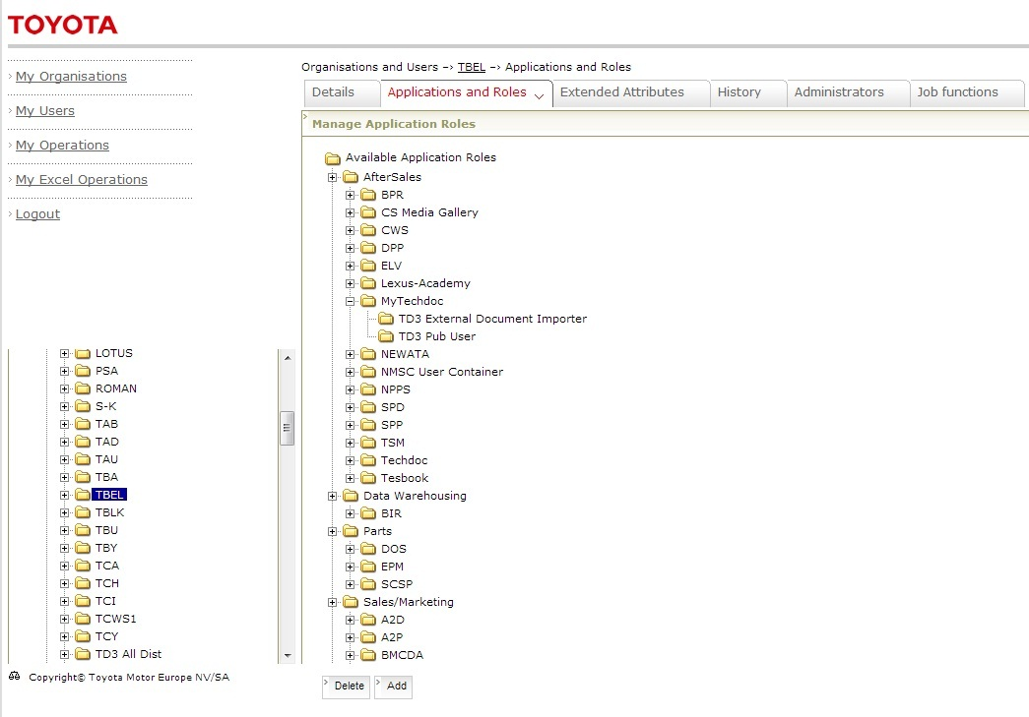
Pre-requisites to upload bulletins
Step # 1
Assign access in User Mgmt system
DOA User set up at NMSC level – Make sure you have the extra role “TD3 External Document Importer” available to your NMSC in DOA/User Management System.
The steps to set the role in DOA are as follows:
Log in to DOA.
Navigate to your NMSC
Select Applications and Roles tab and expand MyTechdoc
Check if TD3 External Document Importer role is present.
If it is not present, click on Add
Select AfterSales > MyTechdoc > TD3 External Document Importer.
If access is to be granted to child organizations (e.g. Dealers) check the box “Make available in all child organizations”
Save
Business needs to raise a service center request for users that need bulletin upload access, to set the extra role to “TD3 External Document Importer” in DOA/User Mgmt. System.

Slide 3
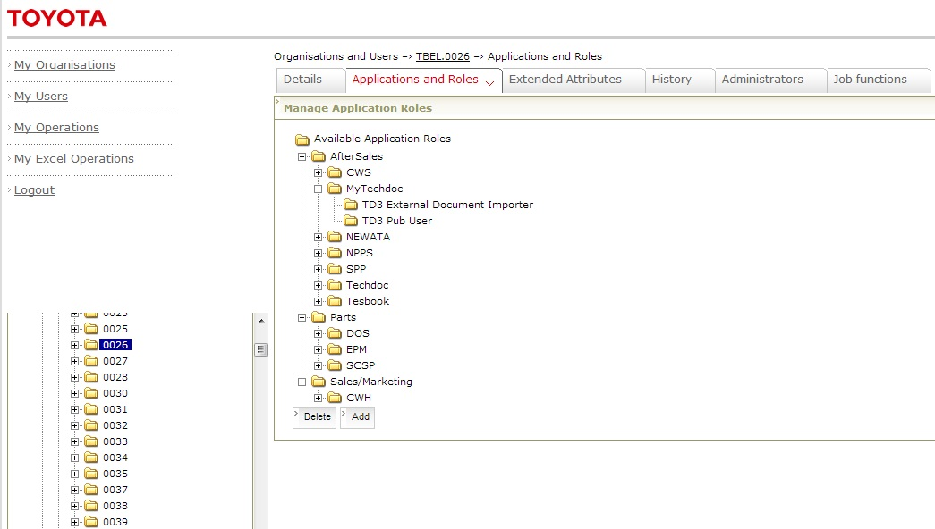
Pre-requisites to upload bulletins
Step # 2
Assign access in User Mgmt system
DOA User set up at Dealer level for Dealers – Make sure you have the extra role “TD3 External Document Importer” available to your Dealer in DOA/User Management System.
The steps to set the role in DOA are as follows:
Navigate to your NMSC > Dealer
Select Applications and Roles tab and expand MyTechdoc
Check if TD3 External Document Importer role is present.
If it is not present, click on Add
Select AfterSales > MyTechdoc > TD3 External Document Importer.
If access is to be granted to child organizations check the box “Make available in all child organizations”
Save
Business needs to raise a service center request for users that need bulletin upload access, to set the extra role to “TD3 External Document Importer” in DOA/User Mgmt. System.

Slide 4
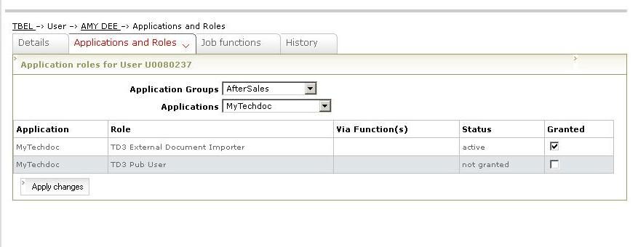
Pre-requisites to upload bulletins
Step # 3
Assign access in User Mgmt system
DOA User set up for Users – Make sure you have the extra role “TD3 External Document Importer” set to Active in DOA/User Management System.
The steps to set the role in DOA are as follows:
1. Go to Applications and Roles > Application Groups – AfterSales > Applications – MyTechdoc
2. Set Granted attribute of ‘TD3 External Document Importer’ to checked (active)
3. Apply changes to save the changes.
Business needs to raise a service center request for users that need bulletin upload access, to set the extra role to “TD3 External Document Importer” in DOA/User Mgmt. System.

Slide 5
Pre-requisites to upload bulletins
Step # 2
Determine roles that need access to upload bulletins in Techdoc3.
A list of roles is available on the TME homepage.
The current list of roles is given below:
NMSC Administrator
NMSC Area Manager
NMSC Bodyshop User
NMSC Document Importer
NMSC Flying Doctor
NMSC General User
NMSC Service Manager
NMSC Tech Support
NMSC Warranty User

Slide 6
Pre-requisites to upload bulletins
Step # 3
Request access to TME to allow user access to upload Bulletins:
Contact Martin or Dirk for setting up this access.
Martin Clarke (Martin.Clarke@toyota-europe.com)
Dirk Matthys (Dirk.Matthys@toyota-europe.com )

Slide 7
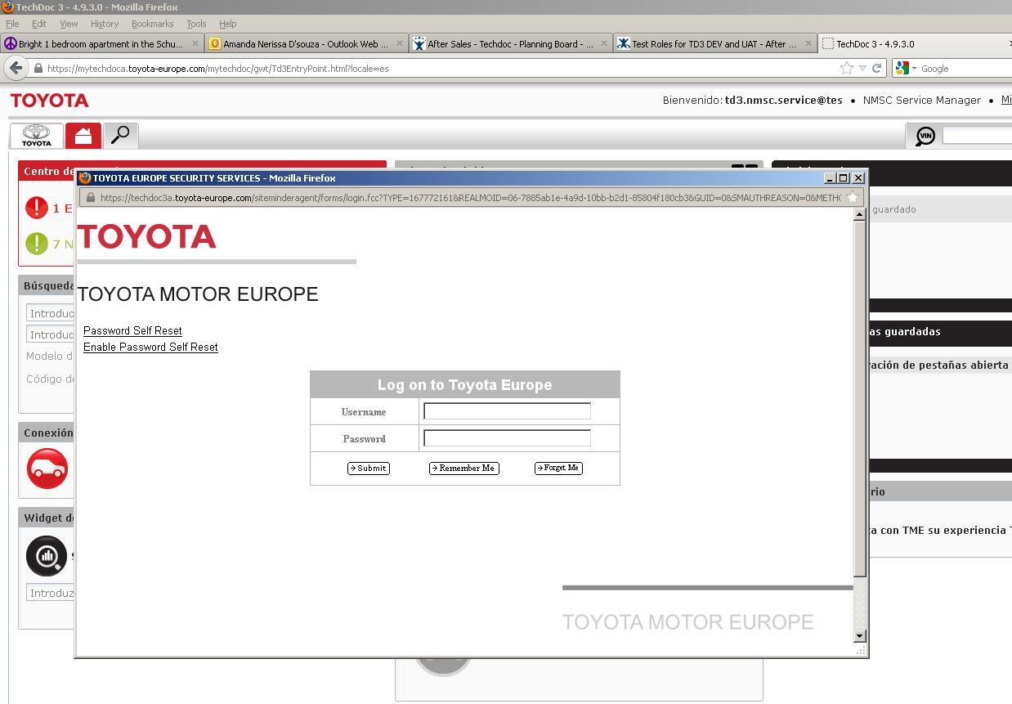
No access to upload bulletins
No access to upload bulletins
In case the NMSC user does not have access to bulletin system (i.e Step 1 is not done), the login screen will be displayed instead of the bulletin upload screen.
Notes:
7

Slide 8
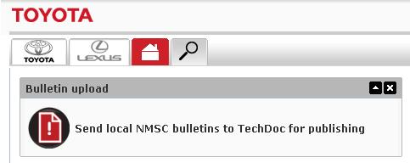
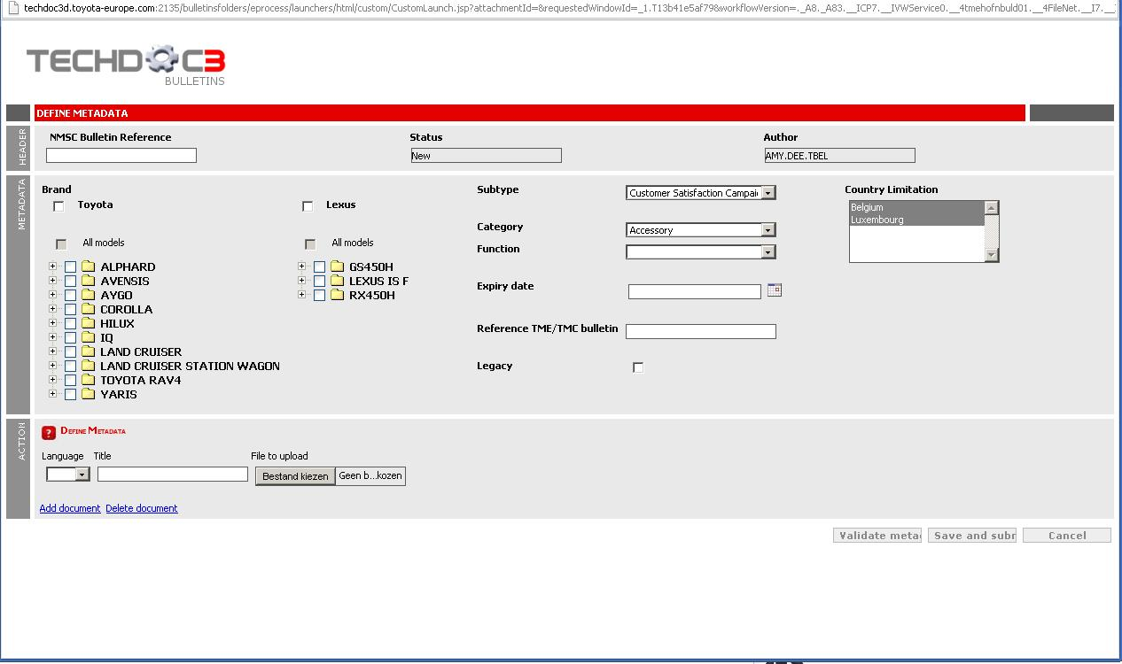
Bulletin Upload
Bulletin Upload Widget
Local Market Bulletin Upload
To upload a local market bulletin to Techdoc3, click on the link “Send local NMSC bulletins to Techdoc for publishing” in the Bulletin Upload widget on Techdoc3 homepage.
This will open the bulletin system interface to enter metadata for the local market bulletin and upload the file.

Slide 9
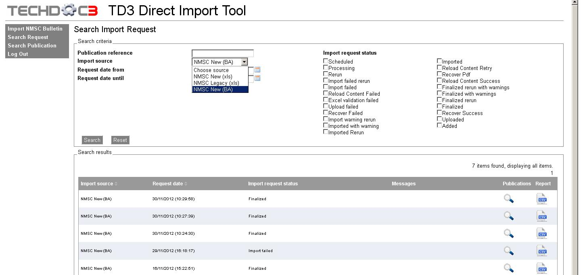
Tracking uploaded bulletins
Tracking Local Market Bulletins
Bulletins that have been uploaded can be tracked in the Migration Tool http://techdoc3.toyota-europe.com/td3import/
In Migration tool, click on “Search Publication” and select Import Source as “NMSC New (BA)” to search for local market bulletins uploaded.
Notes:
9

Slide 10
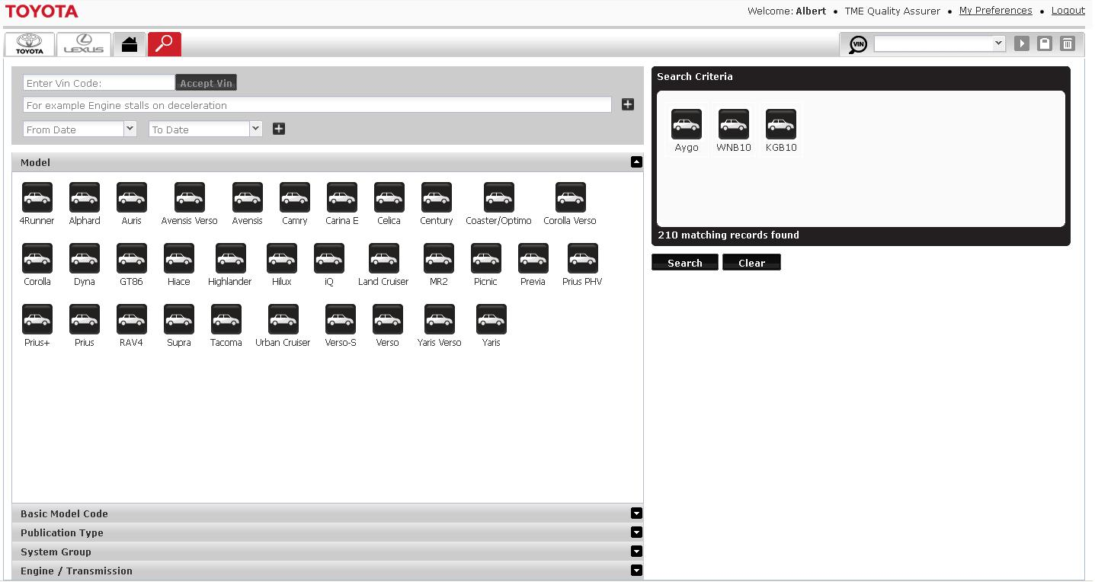
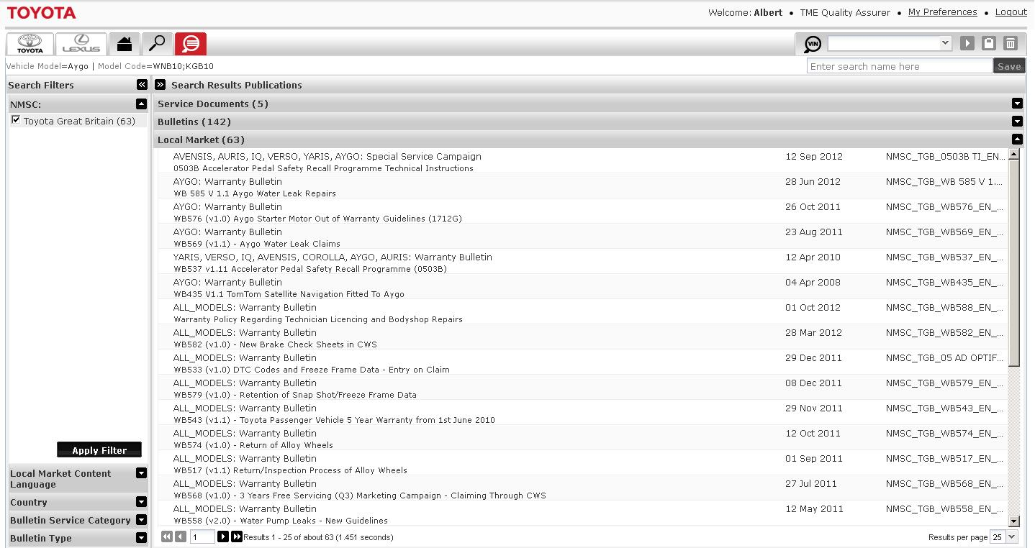
Viewing Bulletins
Viewing Bulletins in Techdoc
Bulletins that have been uploaded can be viewed in Techdoc3, through the search tab http://mytechdoc.toyota-europe.com .
Notes:
10

Slide 11
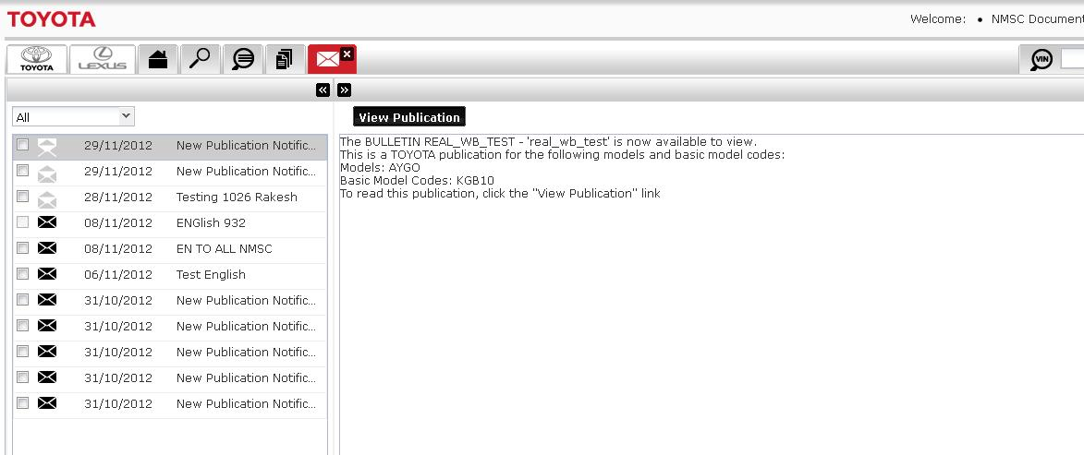
Viewing Bulletins
Viewing Bulletins in Techdoc3
You can also view the bulletin when you receive a notification that the bulletin is published on Techdoc3.
Notes:
11

